Slide 1
Visualization of graphs of financial connections of clients
Bulat Mannapov

Slide 2
About Me
Mannapov Bulat
Higher education
More than 11 years of experience in Sber:
- 9 years in the Internal Audit Service (direction manager, conducting internal audits)
- at the Headquarters of the B2C business block 2 years (IT cost planning)
BIMannapov@sberbank.ru, bmannapov08@gmail.com
Moscow, New York.

Slide 3
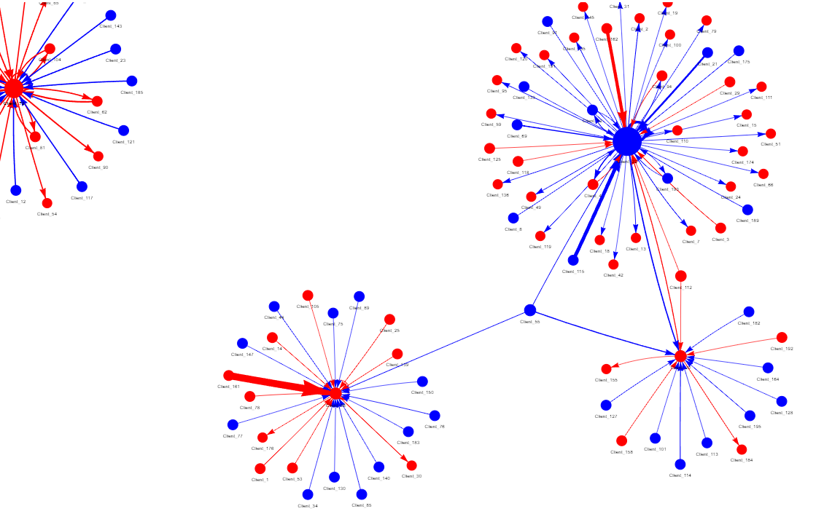
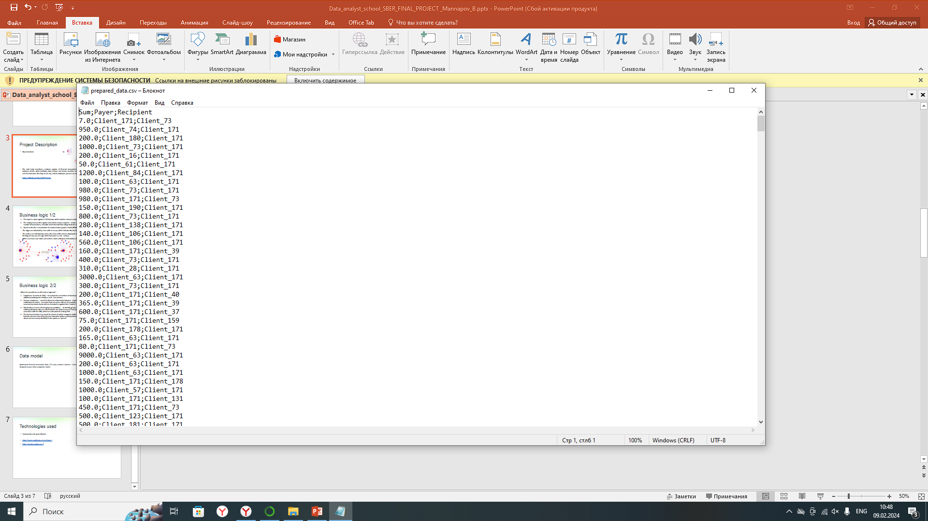
Project Description
How to transform a table with transactions into an interactive visual
graph of relationships
The code helps transform a tabular register of financial transactions into a visualization of financial relationships between clients, which facilitates data analysis and clearly visualizes relationships, incl. under various conditions, in my case the borrower (the flag can be any, a bank employee, persons on various negative lists, etc., etc.).
https://github.com/Bum1987/Project

Slide 4
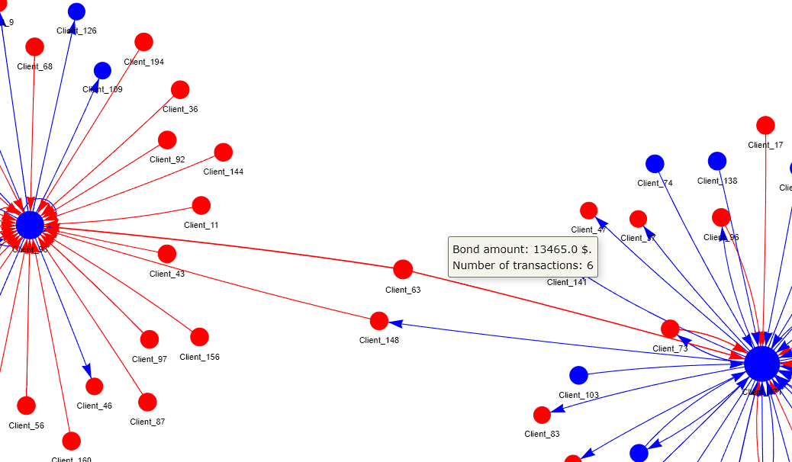
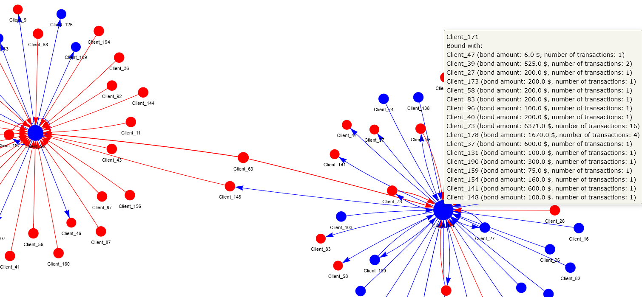
Business logic
The input is a data register in CSV format, which contains columns recipient, sender, transaction amount
The script processes this register and collects unique recipient-sender pairs, calculates the amount of transfers and the number of transactions, and adds client characteristics (flags) from the directory.
Based on the file, a visualization of communication graphs is built (HTML file):
The edges are indicated by a line with an arrow, which indicates the translation direction vector;
The vertices are indicated by circles, the name of the client is displayed next to them, the colors of the vertices depend on the flags (in my case, the sign of the borrower is a red vertex);
When you hover over edges and vertices, labels with basic information about the client connection are shown (see figure)

Slide 5
Business value
Where can this tool or approach be used to benefit?
Compliance (in terms of AML) – to analyze the connections of clients performing dubious transactions and identify additional participants in dubious cash-out schemes.
General compliance – search for financial relationships between employees working in the same process. Internal audit/internal control - to analyze facts of various abuses, for example, analysis of transactions of credits to employee accounts from bank clients who are included in negative lists (“cashers”, “credit fraudsters”, etc.).
Risk function in terms of managing loan portfolios - to identify groups of related borrowers, analysis of legal entities/individuals who are not included in the State Insurance Fund, but after receiving a loan have a stable financial connection with the NHS, which has exhausted its lending limit.
The business function is to search for clients of certain categories (with special features in service) who receive credits from the Pension Funds before reaching retirement age, if they are financially related to clients whom we have clearly identified in the system as “special”.

Slide 6
Data model
Synthesized financial transaction data, 713 rows, contains columns – Sum (transaction amount), Payer (name of the sender’s client), Recipient (name of the recipient’s client).
The model has been tested on a ledger with more than 4 million transactions, it is work also good.

Slide 7
Technologies used
Used pandas and pyvis libraries
https://pyvis.readthedocs.io/en/latest/
https://pandas.pydata.org/

